Slide 1
Exploring Polymorphic Type System
Yashwanth Reddy Kuruganti
Mani Manjusha Kottala
Aakarsh Nadella

Slide 2
Polymorphism[Cardelli & Wegner]
Polymorphic types or functions can have multiple forms i.e., A single interface for different underlying types. Ex: Python, ADA
Implementation: Either Static or Dynamic
Polymorphism
Universal
Ad-hoc
Parametric
Inclusion
Overloading
Coercion

Slide 3

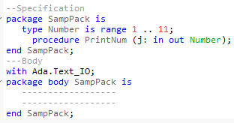
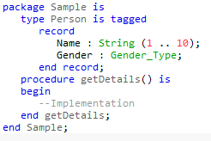

ADA perspective
Static & strong typed, structured, high-level language extended from Pascal
Basic structure of ADA program
Compile:
gnatmake hello.adb>hello
gnatchop –w filename.ada
Class- Tagged record, Package and primitive operations

Slide 4
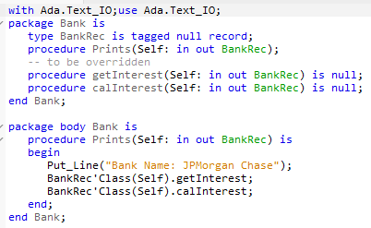
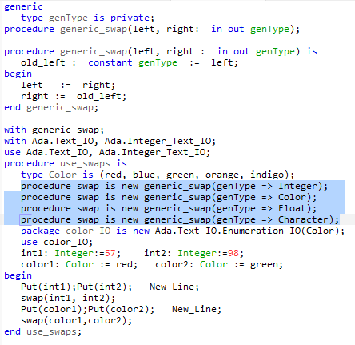
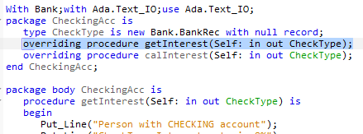
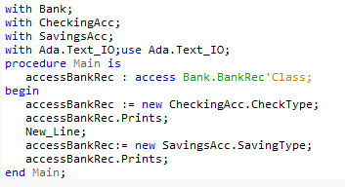
ADA Polymorphism
Parametric(true polymorphism) – same object or a function can behave uniformly for different parameter types: using generics
Inclusion – Replacing an object of super class by sub-class

Slide 5
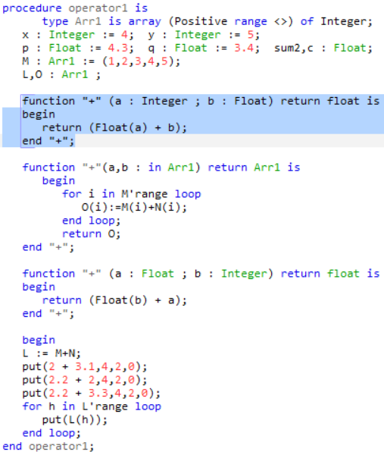
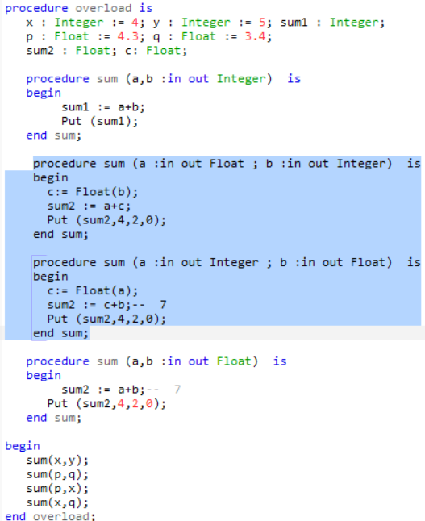
ADA Polymorphism(contd..)
Overloading – Function/ Operator
Operator overloading
ADA doesn’t support creation of own operators, but one can override the existing.
Function overloading
Generic function cant be overloaded in the same package
Coercion
Implicit conversions are discouraged
Type casting is allowed

Slide 6
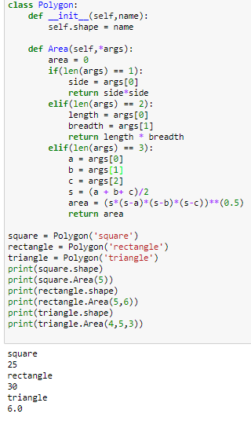
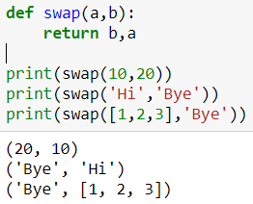
Python perspective- Parametric & Overloading
Dynamic & strongly typed.
Automatic memory management
Parametric polymorphism:
No generics concept in Python
Implicitly polymorphic due to dynamic typing
Overloading
Method overloading
No support for traditional overloading i.e., single method with multi implementation
Can achieve through *args(variable no of args) in method definition

Slide 7
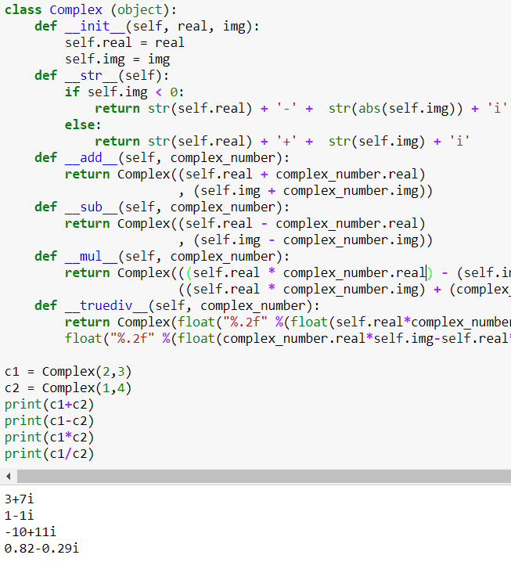
Operator Overloading – Magic functions
Special methods available in python represented as __functionname__
They are not explicitly invoked
All the operators in python have some magic function implementation.
For operator overloading, the magic methods are overloaded in the function definitions.
Some Examples of magic methods :
‘+’ : object.__add()__(self,other)
‘/ ‘: object.__truediv__(self, other)
Unary negation ‘–’ : object.__neg__(self)

Slide 8
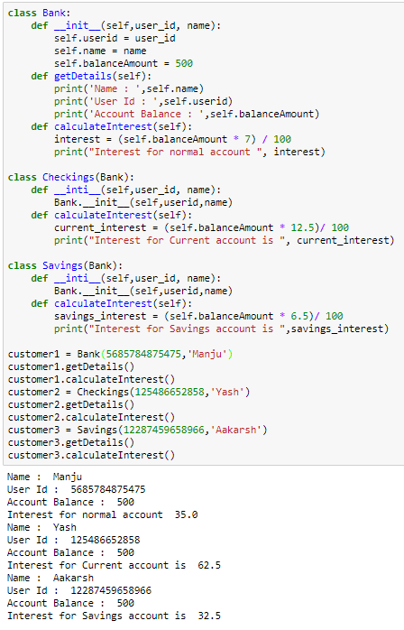
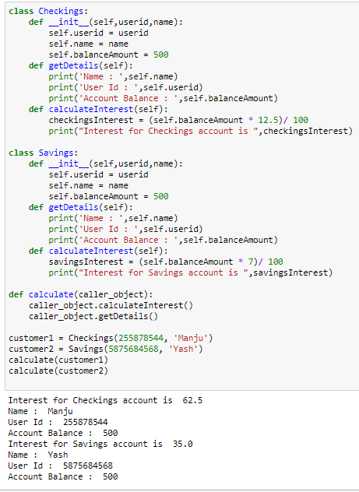
Overriding & Duck typing
Overriding
Doesn’t truly produce inclusion polymorphic behavior due to dynamic typing and late binding
Duck typing
Behavioural sub typing
means that any operation that can be performed, will be performed.

Slide 9
summary
ADA and Python has their own way of implementing polymorphism
Generic in ADA works like C++ template providing parametric polymorphism. Python doesn’t have generic concept but implicitly supports parametric poly.
Both ADA and Python has function and operator overloading
Python shows polymorphic behavior through duck typing
ADA restricts coercion whereas Python supports.
Comparison through syntax and semantics

